Slide 1
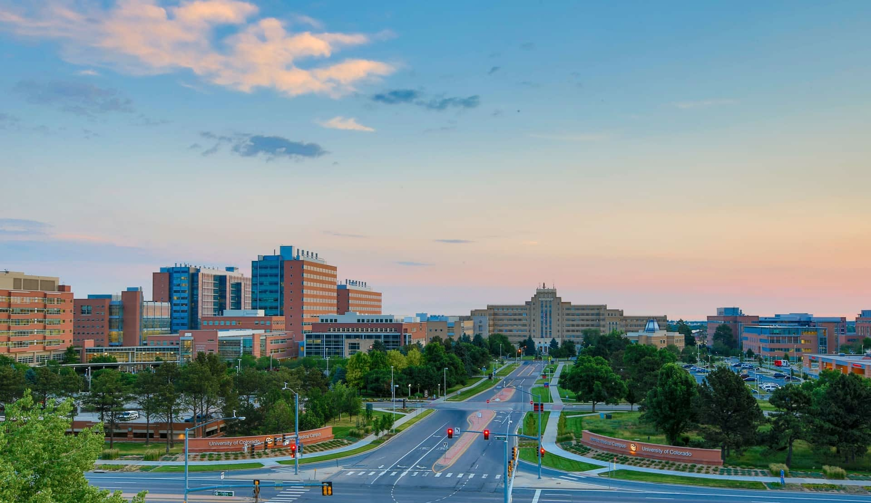
Longitudinal Analysis Project:
Denver Crime Data
Joe Froelicher

Slide 2
Aims
Use random effects to model the neighborhood odds of violent crimes
Model crime over time, incorporating a correlation structure between time points

Slide 3
Analyses
Generalized linear mixed model regression for violent crimes with random effects for neighborhood
Linear Mixed Model comparison for crimes per month in 2018
Comparing higher order terms and covariance structures

Slide 4
Data
N=93391 crimes documented in Denver in 2018
Neighborhood (N=78), traffic crime (binary), time stamp
Neighborhood populations (2010 census)
Denver neighborhood geometries
*all data is publicly available

Slide 5
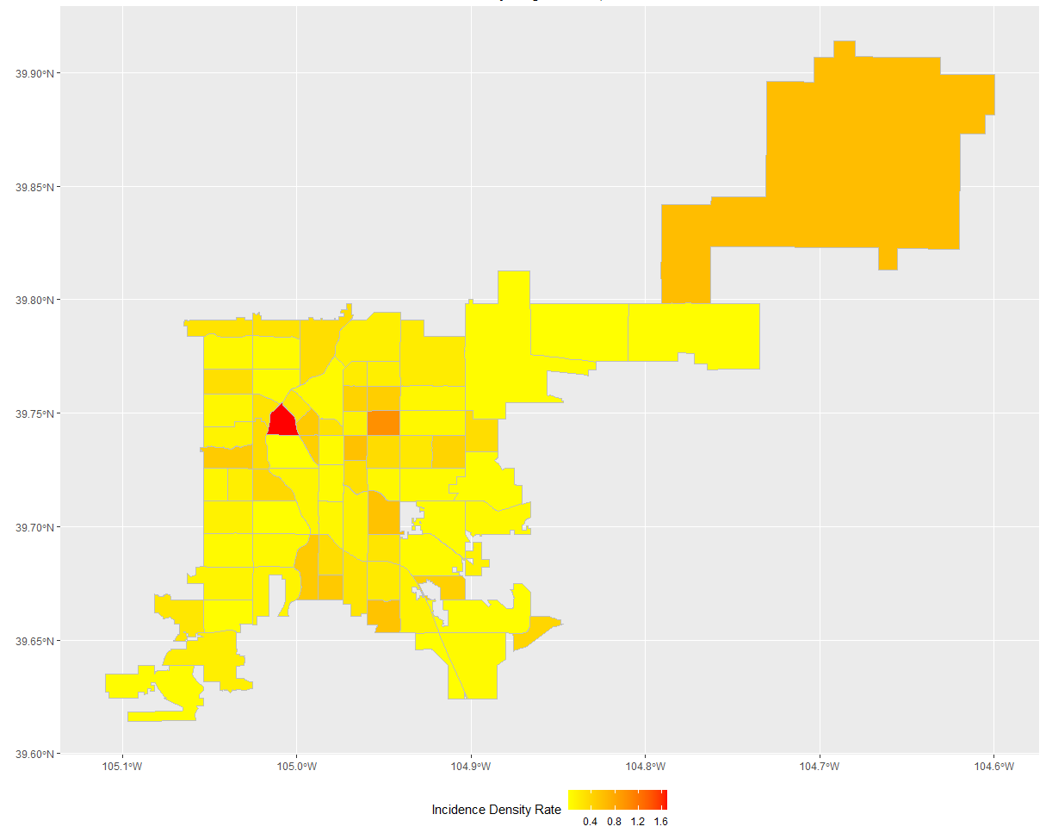
Crime Rates By Neighborhood
Notes:
One year crime incidence density rate (an IDR of 1 means that for every person that lives in that neighborhood, 1 crime was committed in 2018)

Slide 6
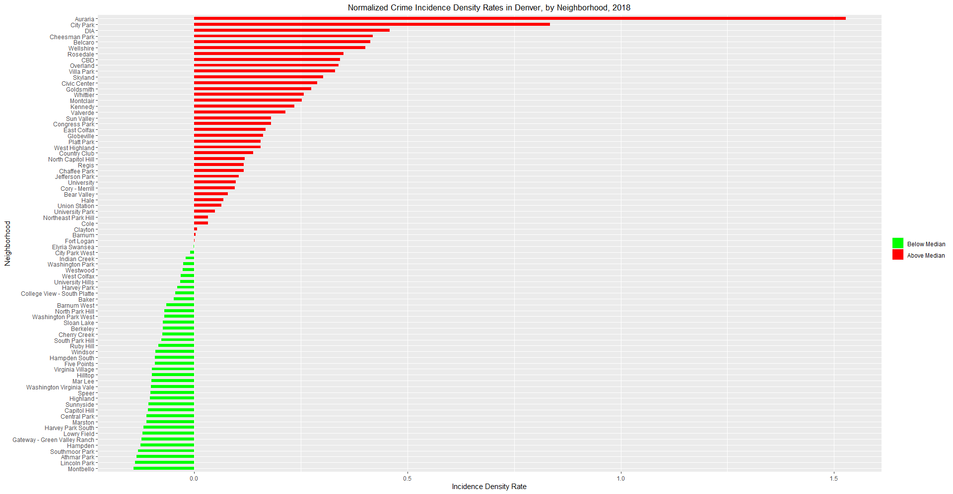
Crime Rates By Neighborhood (Cont.)
Notes:
Normalized to the median, red is above the median, green is below

Slide 7
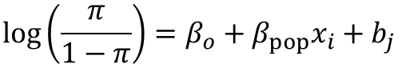
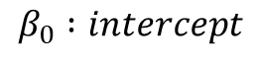
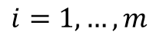
Logistic Mixed Model Regression
$$\log\left(\frac{π}{1−π}\right)=β_{o}+β_{pop}x_{i}+b_{j}$$
$$β_{0} :intercept$$
$$π:probability of crime not being a traffic crime$$
$$1−π:probability of crime being a traffic crime$$
$$i=1, …, m$$
$m :number of crimes$*
$$j=i, …, n$$
$$n :number of neighborhoods$$
$$β_{pop} :regression coefficient for population$$
$b_{j} :effect for neighborhoo$d
$$b_{j}∼N\left(0, G\right)$$
$$G :Unstructured$$
Notes:
Formulation

Slide 8
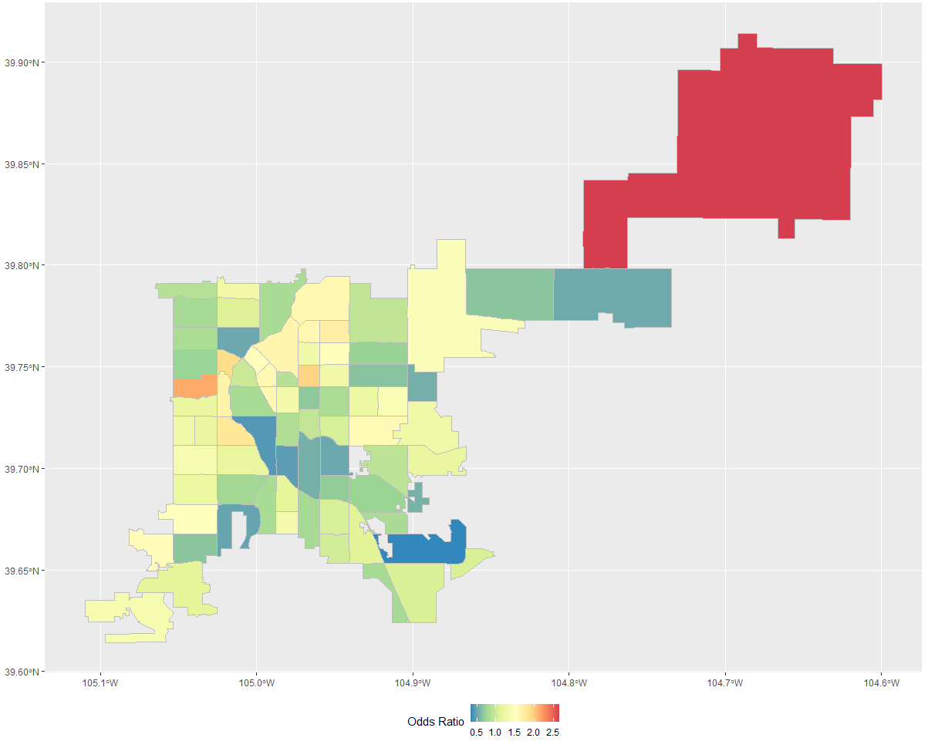
Results of Logistic Regression
Notes:
Odds ratio of 1 means that a crime is equally as likely to not be a traffic crime as it is.

Slide 9
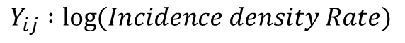
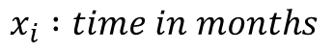
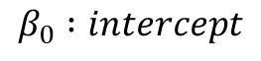
Longitudinal Linear Mixed Model
$$Y_{ij}=β_{o}+β_{t1}x_{i}+β_{t2}x_{i}^{2}+β_{t3}x_{i}^{3}+b_{j}+ε_{ij}$$
$$Y_{ij} :\log{(Incidence density Rate)}$$
$$β_{0} :intercept$$
$$x_{i} :time in months$$
$$β_{t1} :linear regresion coefficient for time$$
$$β_{t2} :square regresion coefficient for time$$
$$β_{t3} :cubic regresion coefficient for time$$
$b_{j} :random intercept for neighborhoo$d
$$b_{j}∼N\left(0, G\right)$$
$$G :Unstructured$$
$$ε_{ij }∼ N\left(0, R\right):repeated measures in each neighborhood$$
$$R :AR\left(1\right), or Heterogeneous−CS$$

Slide 10
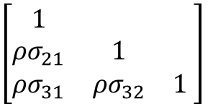
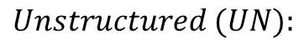
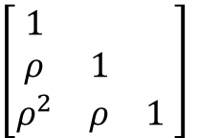
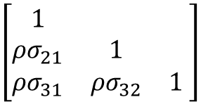
Logistic Mixed Model Regression
$$Unstructured (UN):$$
$$\left[\begin{matrix}1 & & \\ ρσ_{21} & 1 & \\ ρσ_{31} & ρσ_{32} & 1\end{matrix} \right]$$
$$Heterogeneous Compound Symmetry (CSH):$$
$$First−Order Auto Regressive AR(1):$$
$$\left[\begin{matrix}1 & & \\ ρσ_{21} & 1 & \\ ρσ_{31} & ρσ_{32} & 1\end{matrix} \right]$$
$$\left[\begin{matrix}1 & & \\ ρ & 1 & \\ ρ^{2} & ρ & 1\end{matrix} \right]$$
Notes:
Formulation

Slide 11
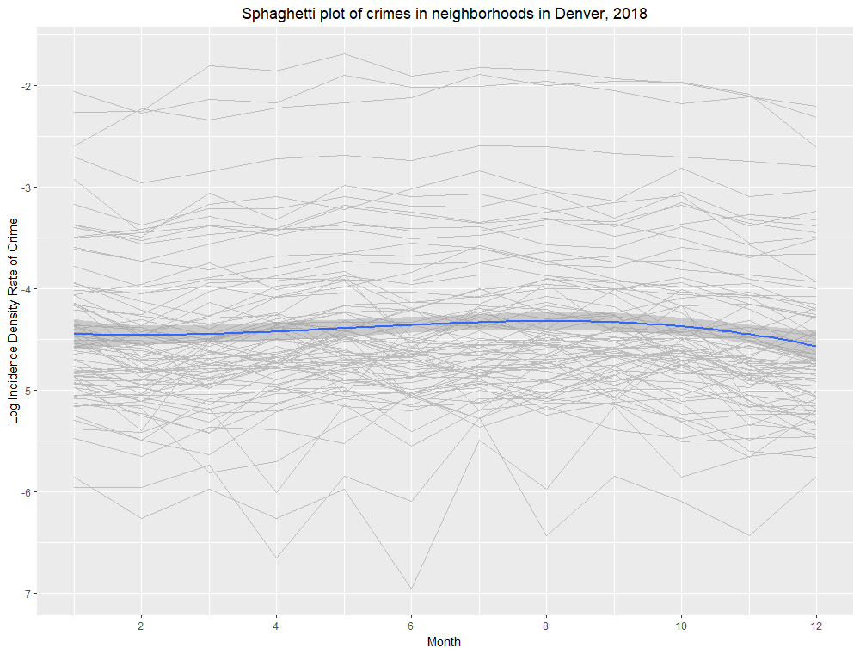
Spaghetti Plot: IDR per Month, 2018
Notes:
This is a spaghetti plot of the log incidence density rate of crimes per month. There is one line for each neighborhood in Denver.

Slide 12
 | Covariance |  | Estimates |  |  | Criterion
Model | Type | Estimate | 1st-order | 2nd-order | 3rd-order | AIC | AICc | BIC
Linear | AR(1) | 0.2678 | 0.997733 | - | - | -79.8 | -79.8 | -68.3
 | CSH | 0.9365 | 1.002957 | - | - | -69.8 | -66.2 | 22.3
Square | AR(1) | 0.1718 | 1.067052* | 0.994913* | - | -134.6 | -134.5 | -120.8
 | CSH | 0.9404 | 1.081242* | 0.99374* | - | -134.3 | -130.4 | -39.8
Cubic | AR(1) | 0.1556 | 0.937545* | 1.019253* | 0.987677* | -170.1 | -169.9 | -153.9
 | CSH | 0.9135 | 0.951077* | 1.01741* | 0.998811* | -177.9 | -173.9 | -81.2
Linear Mixed Model Results
*Statistically significant in the prediction of incidence density rate of crime
Notes:
Results of linear mixed model with exponentiated coefficients
Its worth noting that all terms were significant in the cubic and square models, but the linear term alone is not significant for

Slide 13
Implications
Incidence rate highest in Auraria (downtown)
High crime, low population
Higher Odds of traffic crime along the I-25 corridor
Higher odds of ‘not’ traffic crime at DIA
There is evidence of some sort of serial correlation between months within neighborhoods

Slide 14
Limitations
Crimes committed by moving populations, census data is a static population
Census data from 2010, crimes from 2018 (2020 census data is not available yet)
There is demographic information in the census data, but I chose not to use it for the potential implications
There are more sophisticated modeling techniques for spatial data
Traffic crimes is not necessarily a good indicator for ‘violent’ crimes
High number of parameters in Heterogeneous-CS covariance structure

Slide 15

THANK YOU

